Slide 1
Understand your Bible
Session 36 Acts 14
Welcome

Slide 2
Understand your Bible
Session 36 Acts 14
What we will see in this chapter:
Results of Paul’s preaching in Iconium
Reaction to Paul’s miracle at Lystra
Violent opposition makes Paul and Barnabas move on to Derbe

Slide 3
Understand your Bible
Session 36 Acts 14
Let us read Acts 14

Slide 4
Understand your Bible
Session 36 Acts 14
2. Questions
v 1 to 7. What were the results of the preaching of Paul and Barnabas at Iconium?
Many Jews and Gentiles in Iconium were converted, but there was violent opposition from unbelieving Jews who also incited some Gentiles.
v 8 to 13. What did Paul do at Lystra and how did the crowd react?
Paul healed a crippled man, but the people mistakenly wanted to treat Paul and Barnabas as Roman gods.
v 14 to 18. What did Paul and Barnabas say in response to the crowd?
Paul said that he and Barnabas were only men. He appealed to his hearers to turn away from their gods to the only living God who created everything.

Slide 5
Understand your Bible
Session 36 Acts 14
2. Questions
v 19 and 20. What did the Jews from Antioch and Iconium cause to be done to Paul and what happened?
Jews from Antioch and Iconium persuaded the crowd to stone Paul, who was left for dead, but he made a miraculous recovery.
v 21 to 23. What did Paul and Barnabas say to encourage the believers at Lystra, Iconium and Antioch?
They encouraged them to continue in the faith, and said that through many afflictions we must enter into God’s Kingdom.

Slide 6
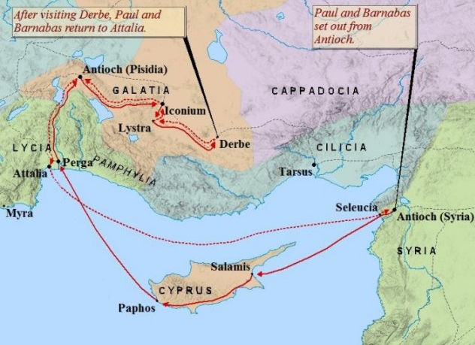
Session 36 Acts 14
2. Questions
v 24 to 28. Where did Paul pass through on his way back to Antioch in Syria? You can find the places on the map.
Pisidia, Pamphylia, Perga, and Attalia.

Slide 7
Understand your Bible
Session 36 Acts 14
3. Related theme from v 15:
God - the Creator.
Verse(s)
Main point(s)
Genesis 1 v 1
God created the heavens and the earth “in the beginning”.
Exodus 20 v 11
Because God made the heaven and earth in six days and rested on the seventh day, he made the seventh day holy.
1 Chronicles 16 v 26
The letter to the Hebrews tells us that Jesus now appears in God’s presence for us.
Psalms 33 v 6
God made the heavens by His word.

Slide 8
Understand your Bible
Session 36 Acts 14
3. Related theme from v 15:
God - the Creator.
Verse(s)
Main point(s)
Isaiah 45 v 18
God made the earth to be lived on.
Acts 17 v 24
God made the heaven and earth and doesn’t live in man-made buildings.
Revelation 4 v 11
Because God made everything, he is worthy of our respect.

Slide 9
Understand your Bible
Session 36 Acts 14
Comments or questions

