Slide 1
Understand your Bible
Session 41 Acts 20
Welcome

Slide 2
Understand your Bible
Session 41 Acts 20
What we will see in this chapter:
Paul’s travels in Macedonia and Greece
Paul’s warning to the elders at Ephesus

Slide 3
Understand your Bible
Session 41 Acts 20
Let us read Acts 20

Slide 4
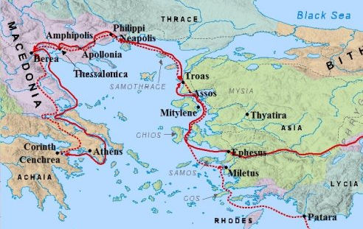
Understand your Bible
Session 41 Acts 20
2. Questions
v 1 to 6. Where did Paul go and what did he become aware of after leaving Ephesus (where the uproar was)?
After leaving Ephesus, Paul went to Macedonia and then Greece where he became aware of a Jewish plot against him. He then retraced his steps and came to Troas.

Slide 5
Understand your Bible
Session 41 Acts 20
2. Questions
v 7 to 12. When did the disciples gather together to break bread and what happened to Eutychus?
They gathered on the first day of the week.
During a long evening talk at Troas, Eutychus fell asleep and fell from a third-floor window, but was healed by Paul.
v 13. What were the two ways Paul and the rest of his party went to Assos?
Paul went by land. The rest of his party went by ship.

Slide 6
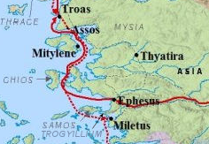
Understand your Bible
Session 41 Acts 20
2. Questions
v 14 to 17. Where did they go then and what did Paul do there?
They went to Miletus via Samos and Trogyllium. Paul sent for the elders of the assembly at Ephesus.

Slide 7
Understand your Bible
Session 41 Acts 20
2. Questions
v 18 to 24. What did Paul tell the Ephesian elders about his past life and what he was expecting?
He told them he had:
served the Lord with all humility
had trials because of plots of the Jews
taught repentance and faith in Jesus
He was expecting trouble in Jerusalem.

Slide 8
Understand your Bible
Session 41 Acts 20
2. Questions
v 25 to 35. What did Paul remind them he had done for them and what did he warn them about?
He had given them the complete message from God about His Kingdom.
He warned them that false teachers would come from within the assembly. They should be careful and continue work for the Lord.
v 36 to 38. What did they do as Paul was leaving?
They prayed and wept together.

Slide 9
Understand your Bible
Session 41 Acts 20
3. Related theme from v 29:
God's message will be corrupted.
Verse(s)
Main point(s)
Colossians 2 v 8
The apostle Paul tells the believers at Colossae to resist deceptive ideas.
1 Timothy 4 v 1 and 2
The Spirit has said that in latter times some will listen to liars and fall away from the faith.
2 Timothy 4 v 3 and 4
The time will come when people will listen to teachers who have their own ideas and be turned away from the truth.

Slide 10
Understand your Bible
Session 41 Acts 20
3. Related theme from v 29:
God's message will be corrupted.
Verse(s)
Main point(s)
1 John 4 v 1
The apostle John tells the believers to test the spirits (ideas) to see if they come from God because there are many false prophets around.

Slide 11
Understand your Bible
Session 41 Acts 20
Comments or questions

