Slide 1
Understand your Bible
Session 42 Acts 21
Welcome

Slide 2
Understand your Bible
Session 42 Acts 21
What we will see in this chapter:
Events on Paul’s journey to Jerusalem
Problems he encountered there

Slide 3
Understand your Bible
Session 42 Acts 21
Let us read Acts 21

Slide 4
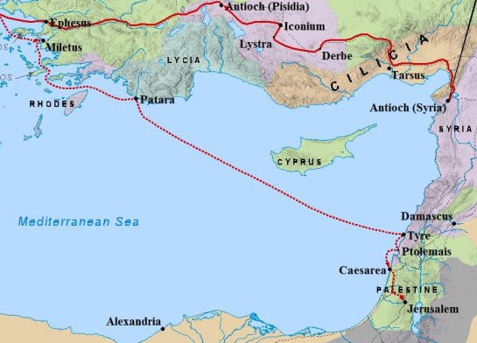
Understand your Bible
Session 42 Acts 21
2. Questions
v 1 to 6. Where did Paul’s ship land and what did he do there?
He landed at Tyre. He found disciples and stayed with them for seven days.

Slide 5
Understand your Bible
Session 42 Acts 21
2. Questions
v 7 to 14. What was Paul told by Agabus and what was his response?
He was warned that the Jews at Jerusalem would arrest him and hand him over to the Gentiles.
He said he was not only ready to be arrested; he was ready to die at Jerusalem for the name of the Lord Jesus.
v 15 and 16. Who did Paul stay with in Jerusalem?
He stayed with Mnason of Cyprus, an early disciple.

Slide 6
Understand your Bible
Session 42 Acts 21
2. Questions
v 17 to 21. What problem with Jewish believers did James and the elders point out to Paul?
Some Jewish believers were unhappy about the report that Paul was telling Jews to forsake Moses, telling them not to circumcise their children and not to keep the Jewish customs.
v 22 to 26. What did James and the elders tell Paul to do?
They advised Paul to show them that he himself kept the law. They asked him to join and support four men who were keeping the rituals of the law of Moses.

Slide 7
Understand your Bible
Session 42 Acts 21
2. Questions
v 27 to 30. What did Paul tell the Ephesian elders about his past life and what he was expecting?
They stirred up the entire multitude accusing him of speaking against the [Jewish] people, the law and the temple. They accused him of defiling the temple with non-Jews and dragged him out of the temple.
v 31 to 36. How did the commanding officer react to the news of what was happening?
The commanding officer arrested Paul, put him in chains and asked who he was and what he had done.

Slide 8
Understand your Bible
Session 42 Acts 21
2. Questions
v 37 to 40. What did the commanding officer discover about Paul and what was Paul allowed to do?
He discovered that Paul was from Tarsus, an important city, and wasn’t the criminal he thought he was.
He was allowed to speak to the people.

Slide 9
Understand your Bible
Session 42 Acts 21
3. Related theme from v 14:
Submitting to God's will.
Verse(s)
Main point(s)
1 Samuel 3 v 16 to 18
The high priest Eli was prepared to accept the message God gave to the child Samuel.
Job 1 v 21
Job accepted the trouble that God sent in his life.
Mark 14 v 35 and 36
The Lord Jesus Christ submitted to what God wanted despite not wanting to do so.

Slide 10
Understand your Bible
Session 42 Acts 21
3. Related theme from v 14:
Submitting to God's will.
Verse(s)
Main point(s)
Hebrews 12 v 9
Just as our natural father disciplined us for our good, so we should accept the discipline that God sends, because that is also for our good.
James 4 v 13 to 15
We should realise that sometimes our plans may not happen if they are not according to God’s will.
1 Peter 5 v 6
The apostle Peter tells us to humble ourselves under God’s mighty hand.

Slide 11
Understand your Bible
Session 42 Acts 21
Comments or questions

